Slide 1
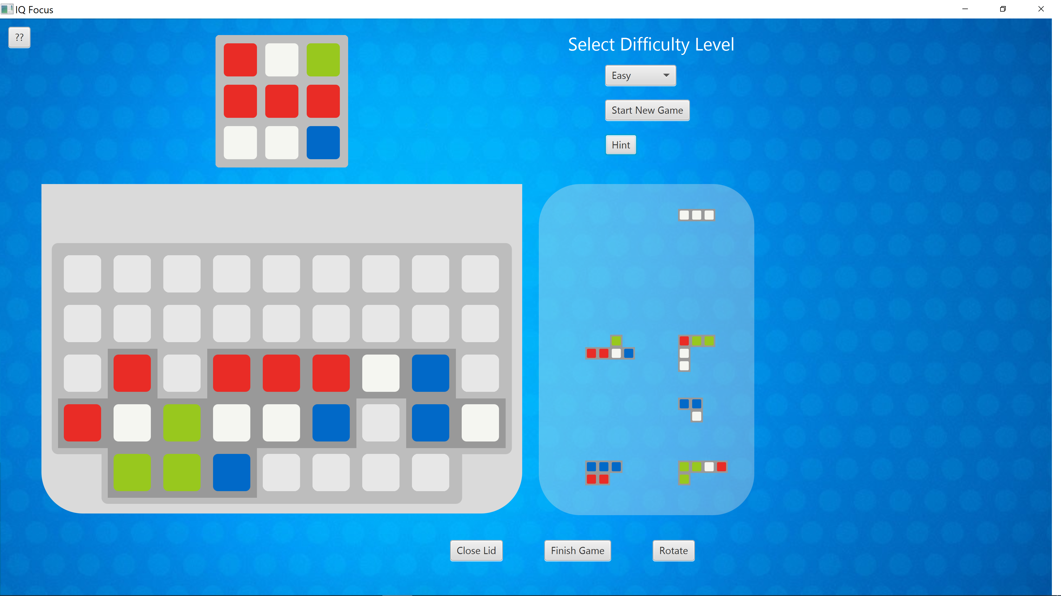
Structured Programming
COMP 1110
IQ Focus
Ra Mugattarov u6650903
Yubeng Liang u6192835
Baoyu Ma u6918231

Slide 2
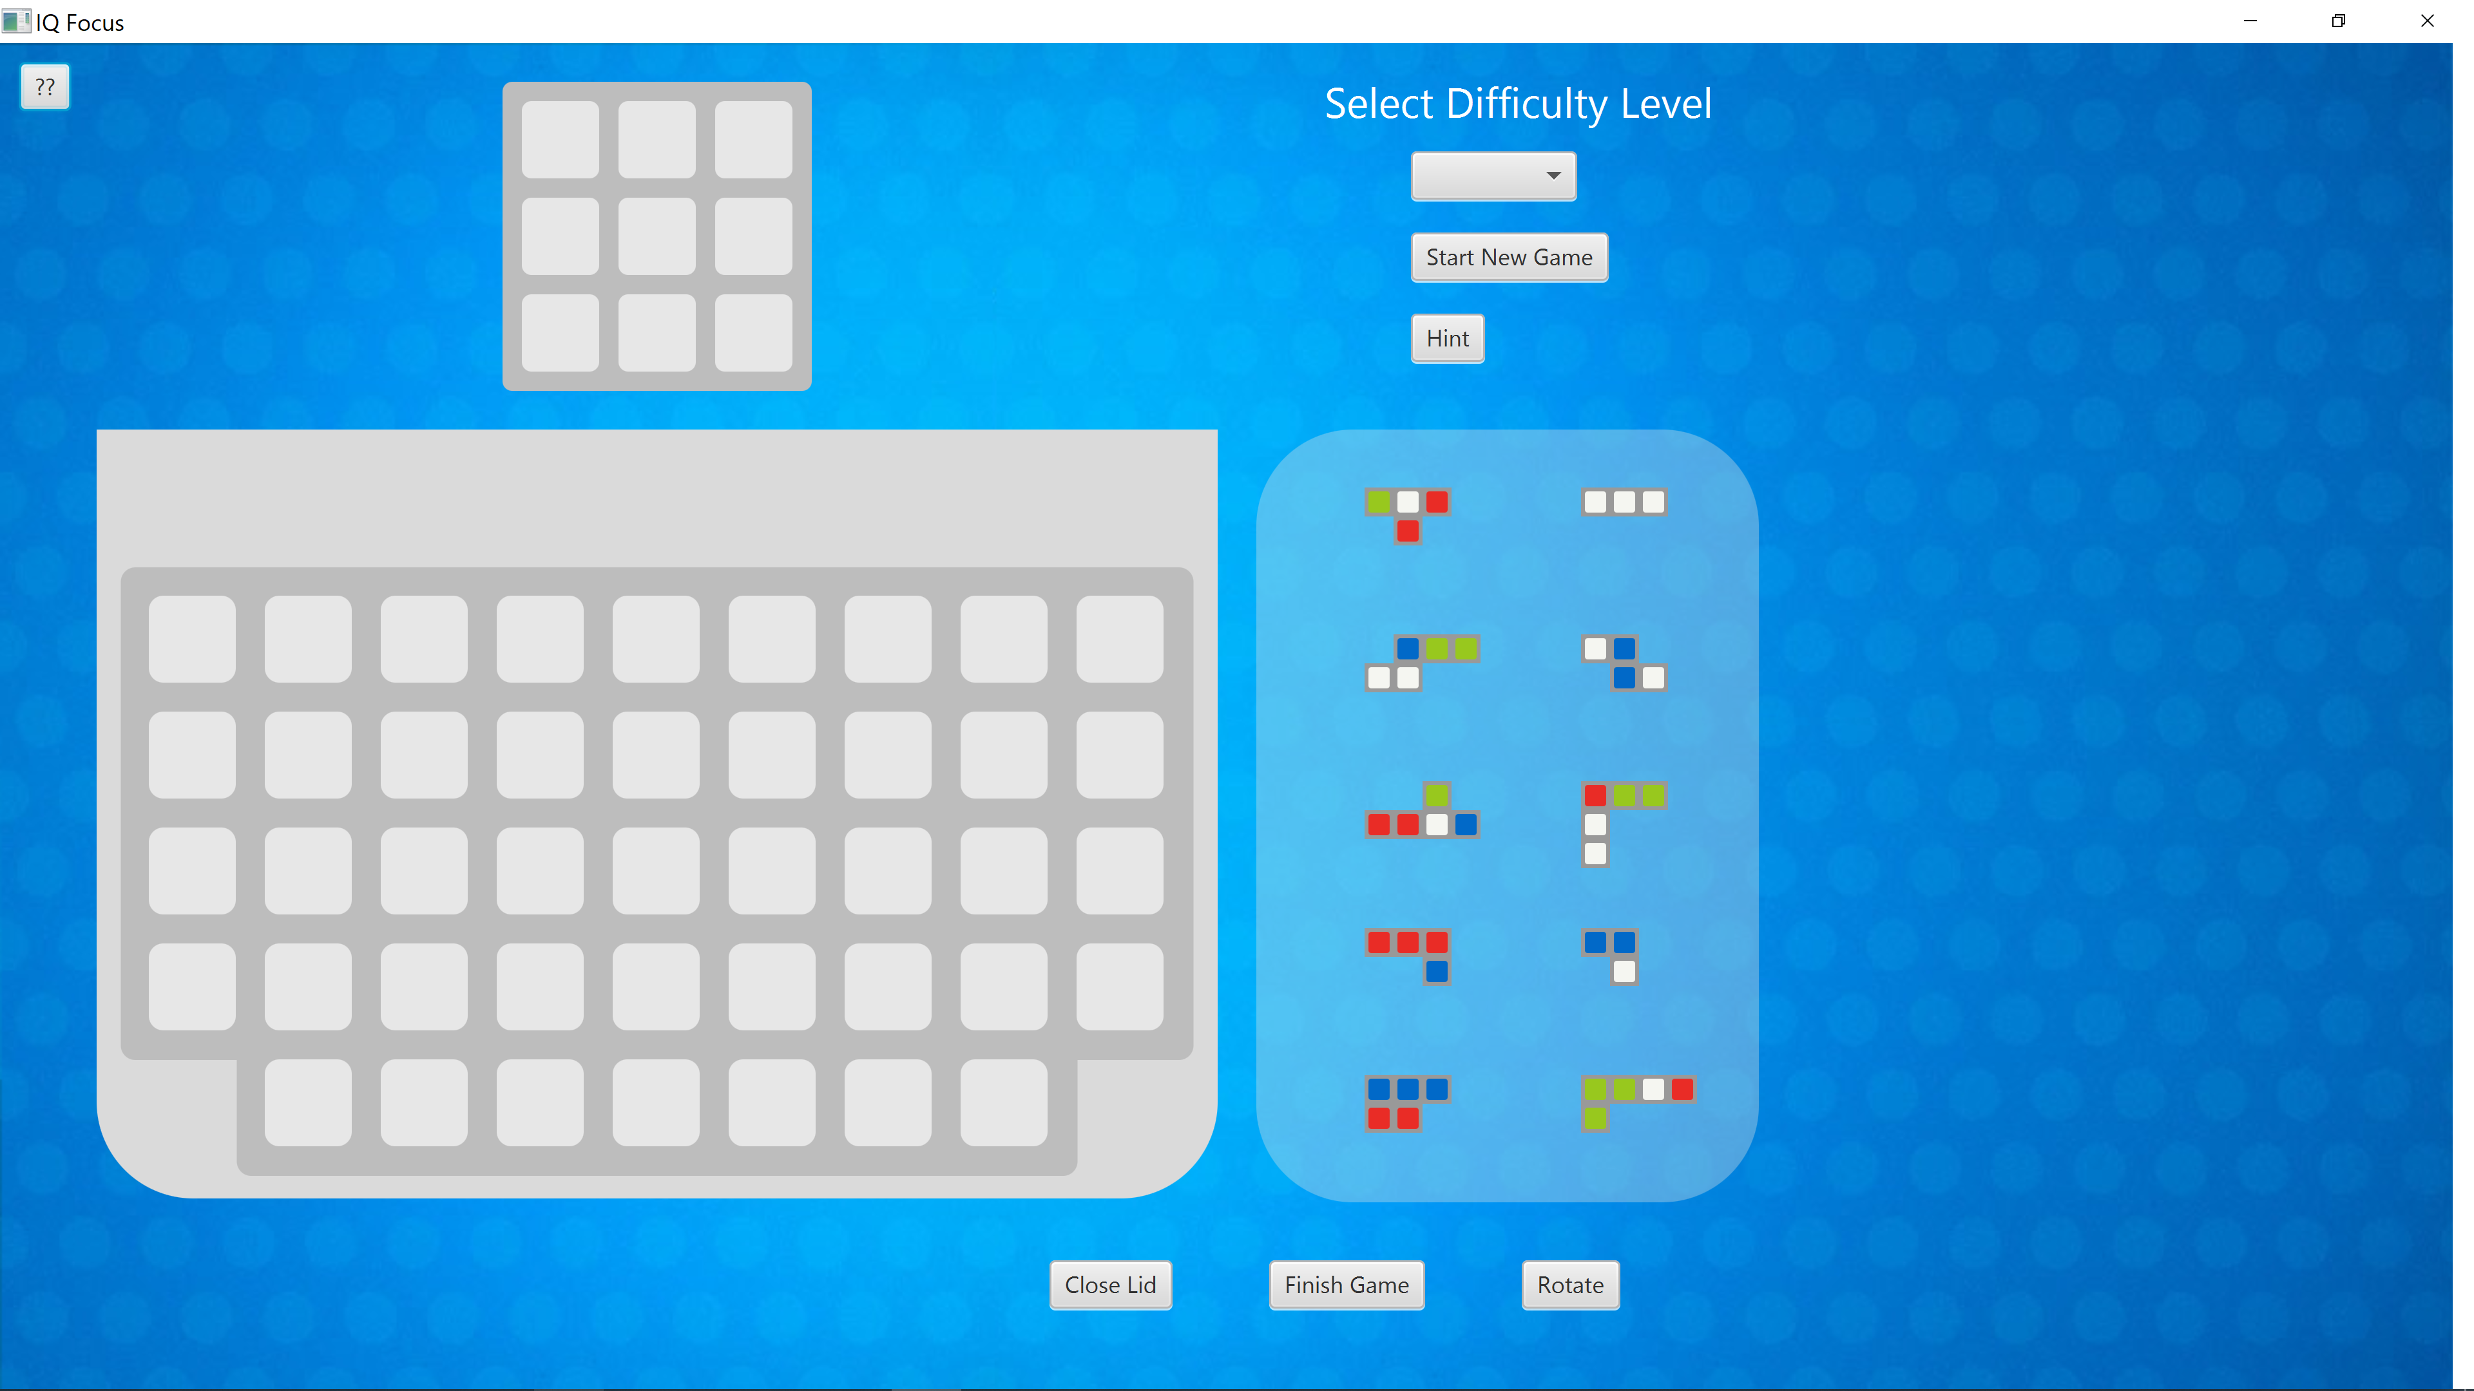

Slide 3
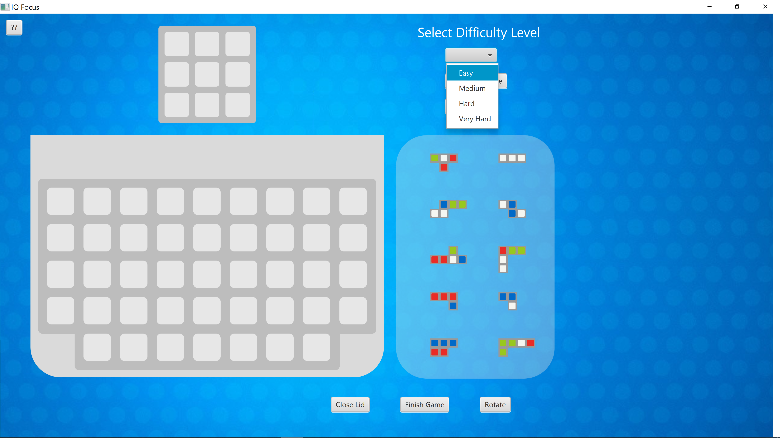

Slide 4


Slide 5
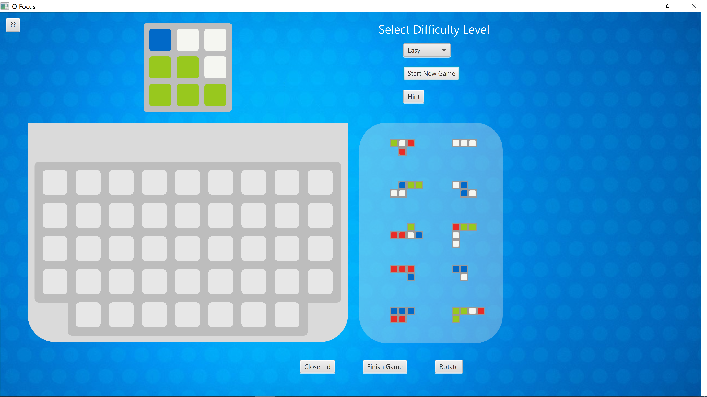

Slide 6


Slide 7


Slide 8


Slide 9


Slide 10


Slide 11
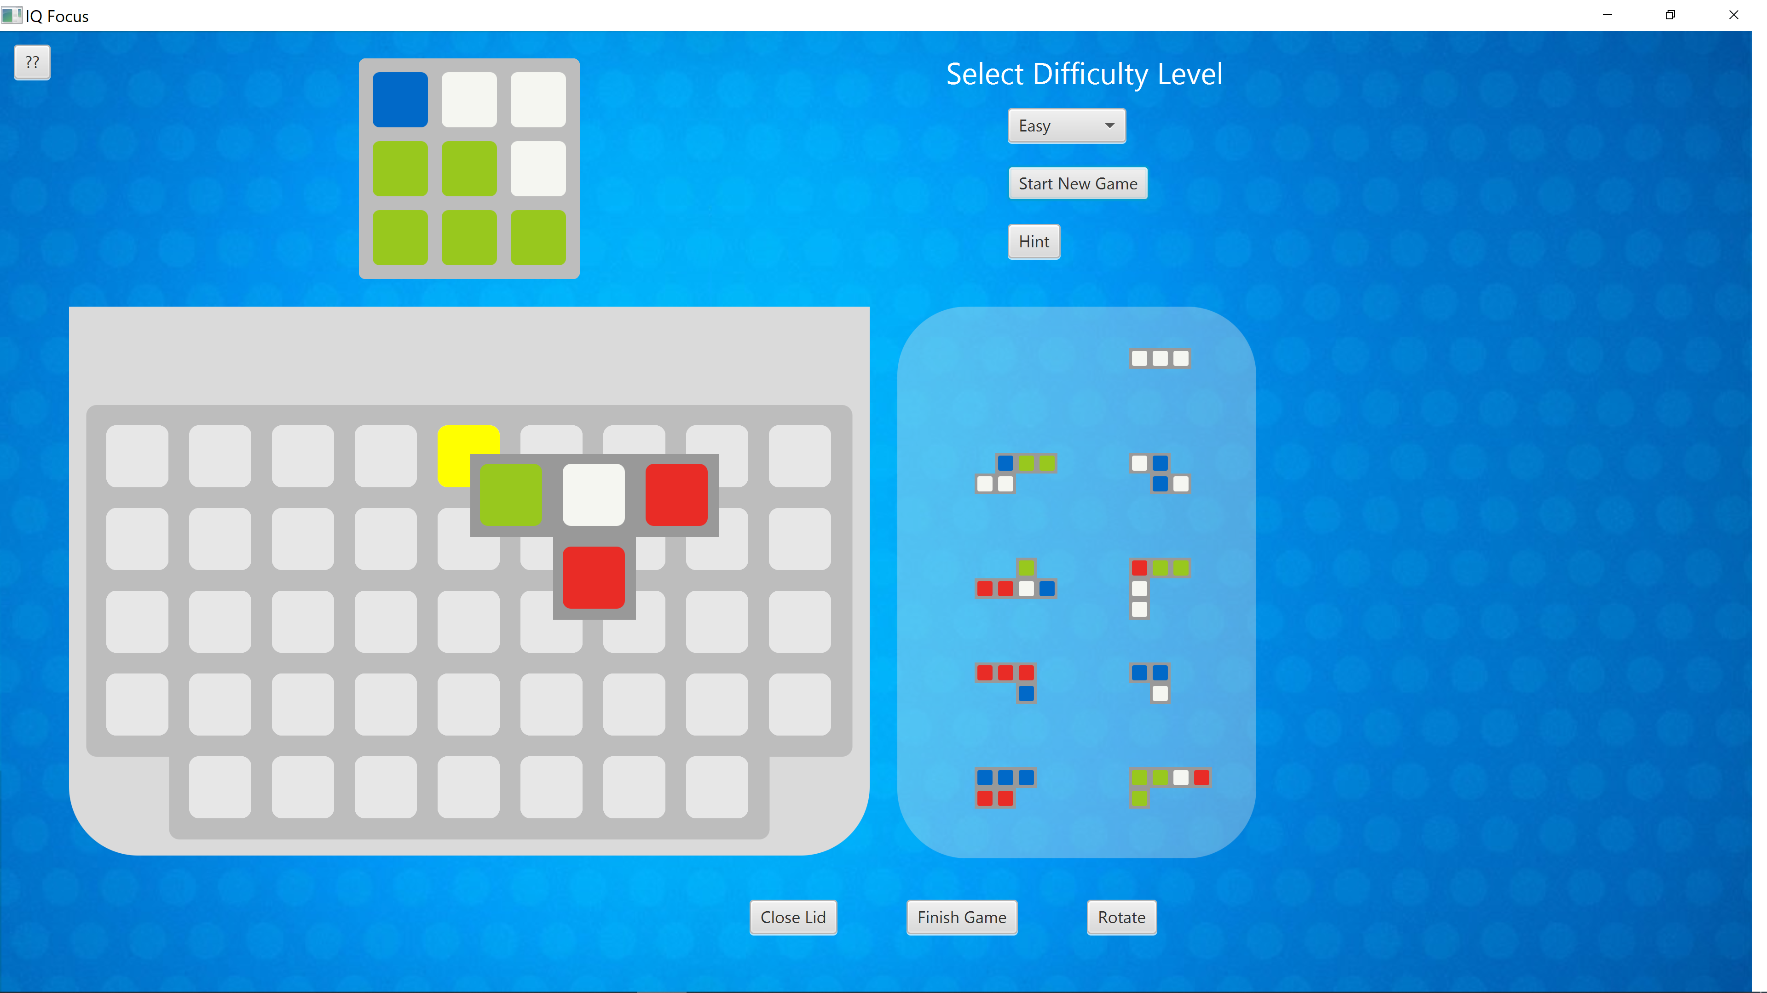

Slide 12
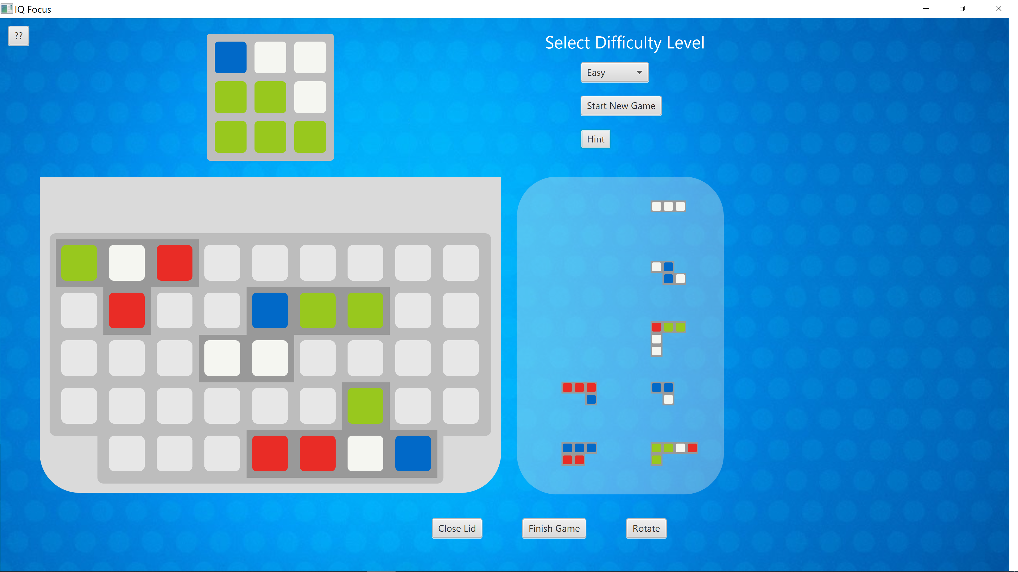

Slide 13
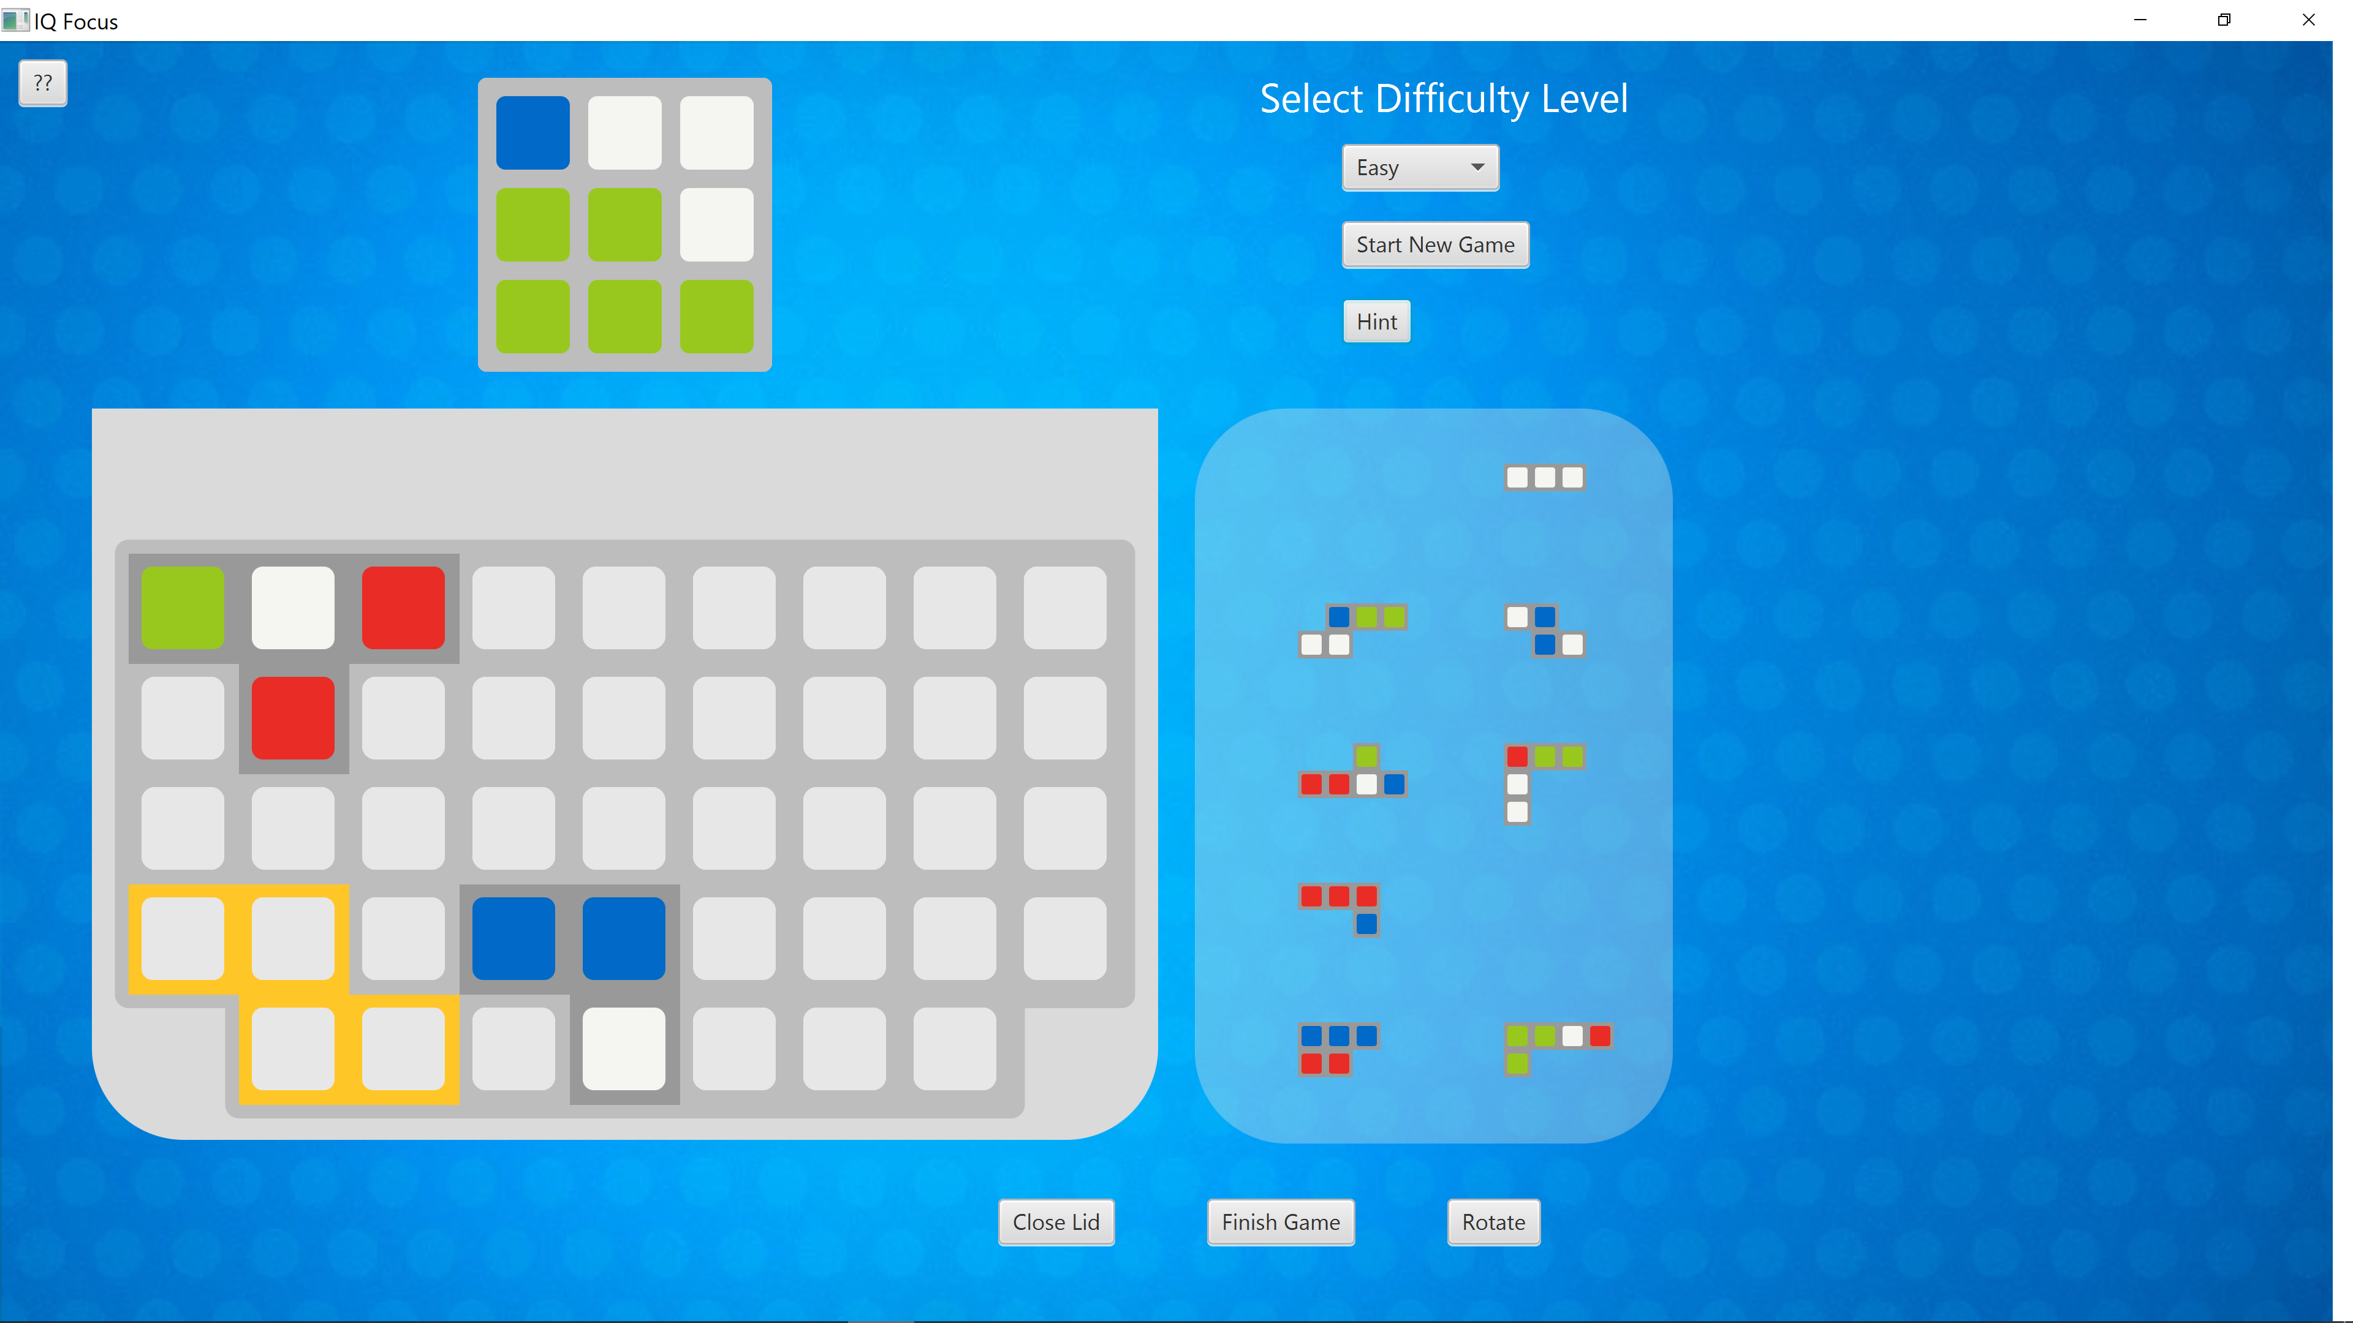

Slide 14


Slide 15
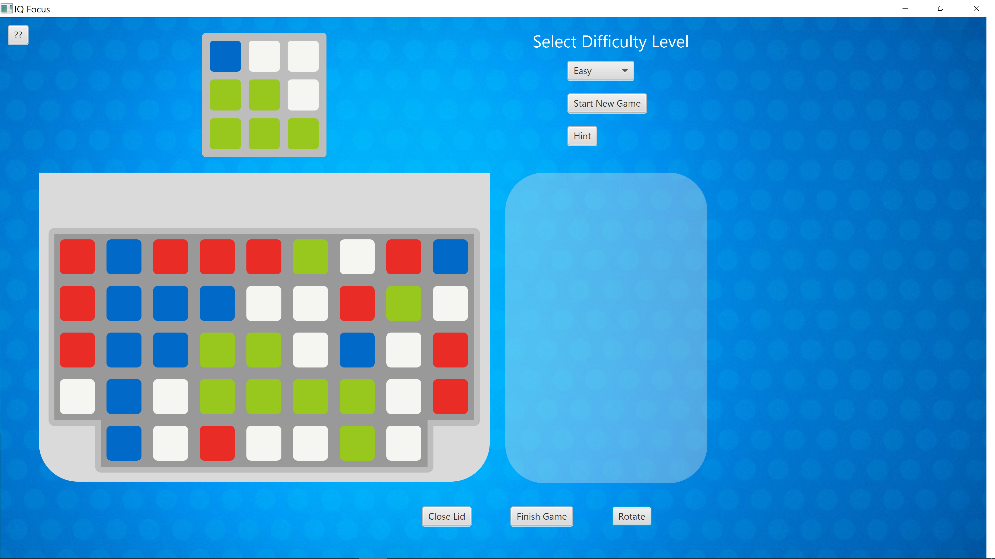

Slide 16
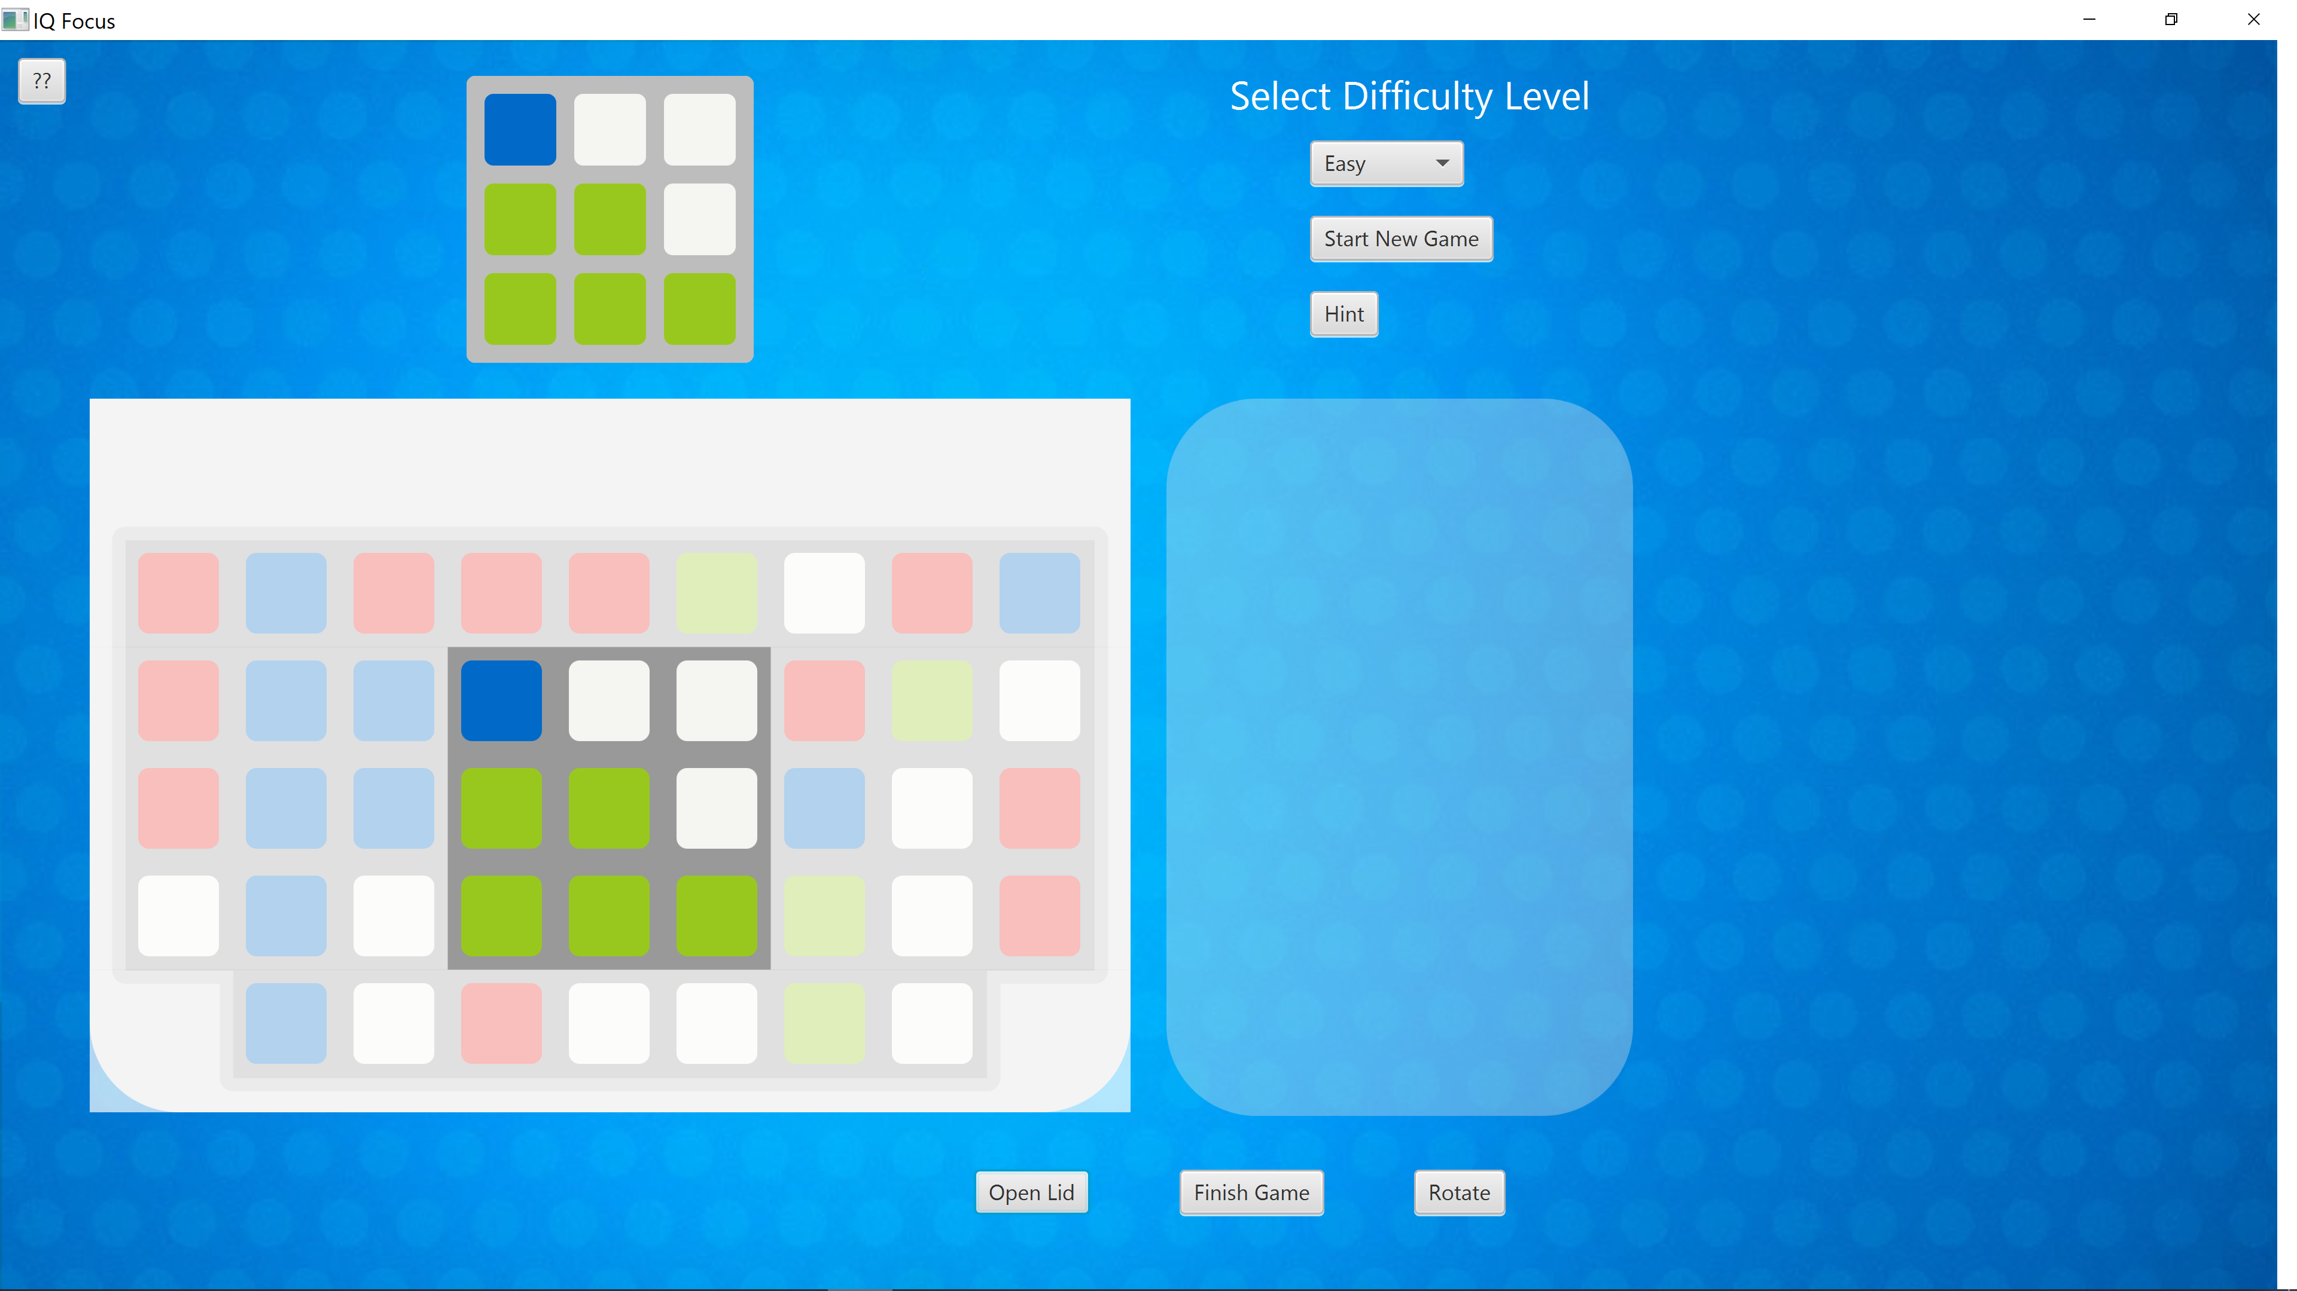

Slide 17
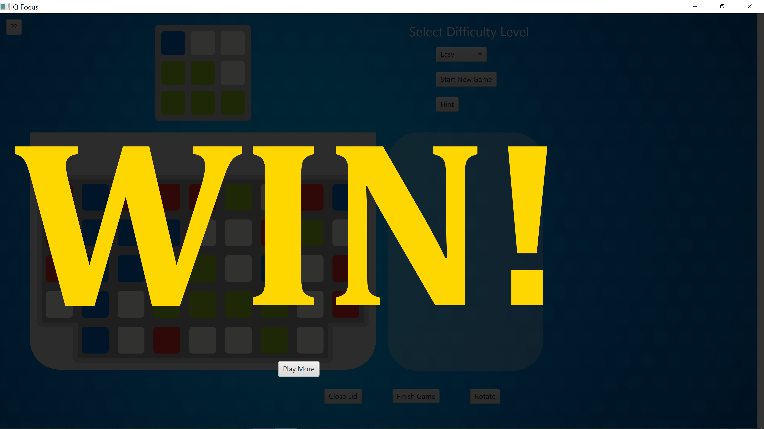

Slide 18


Slide 19
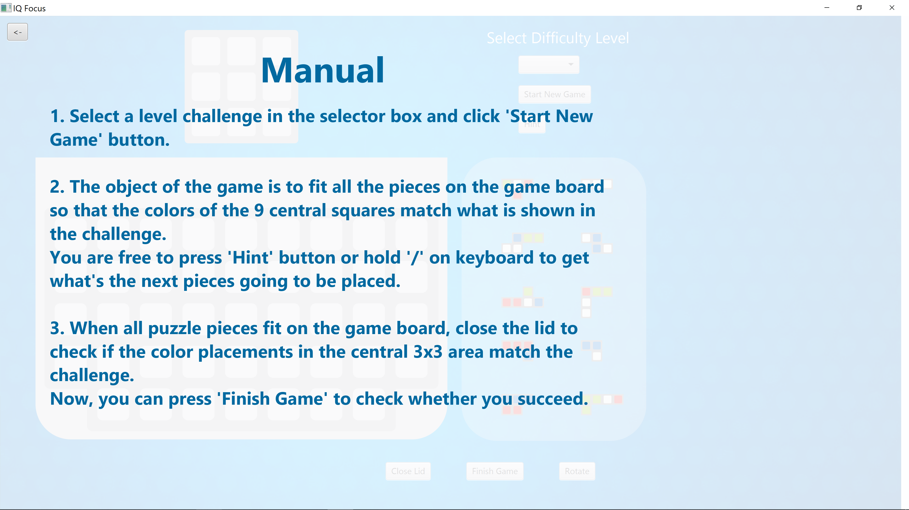

Slide 20
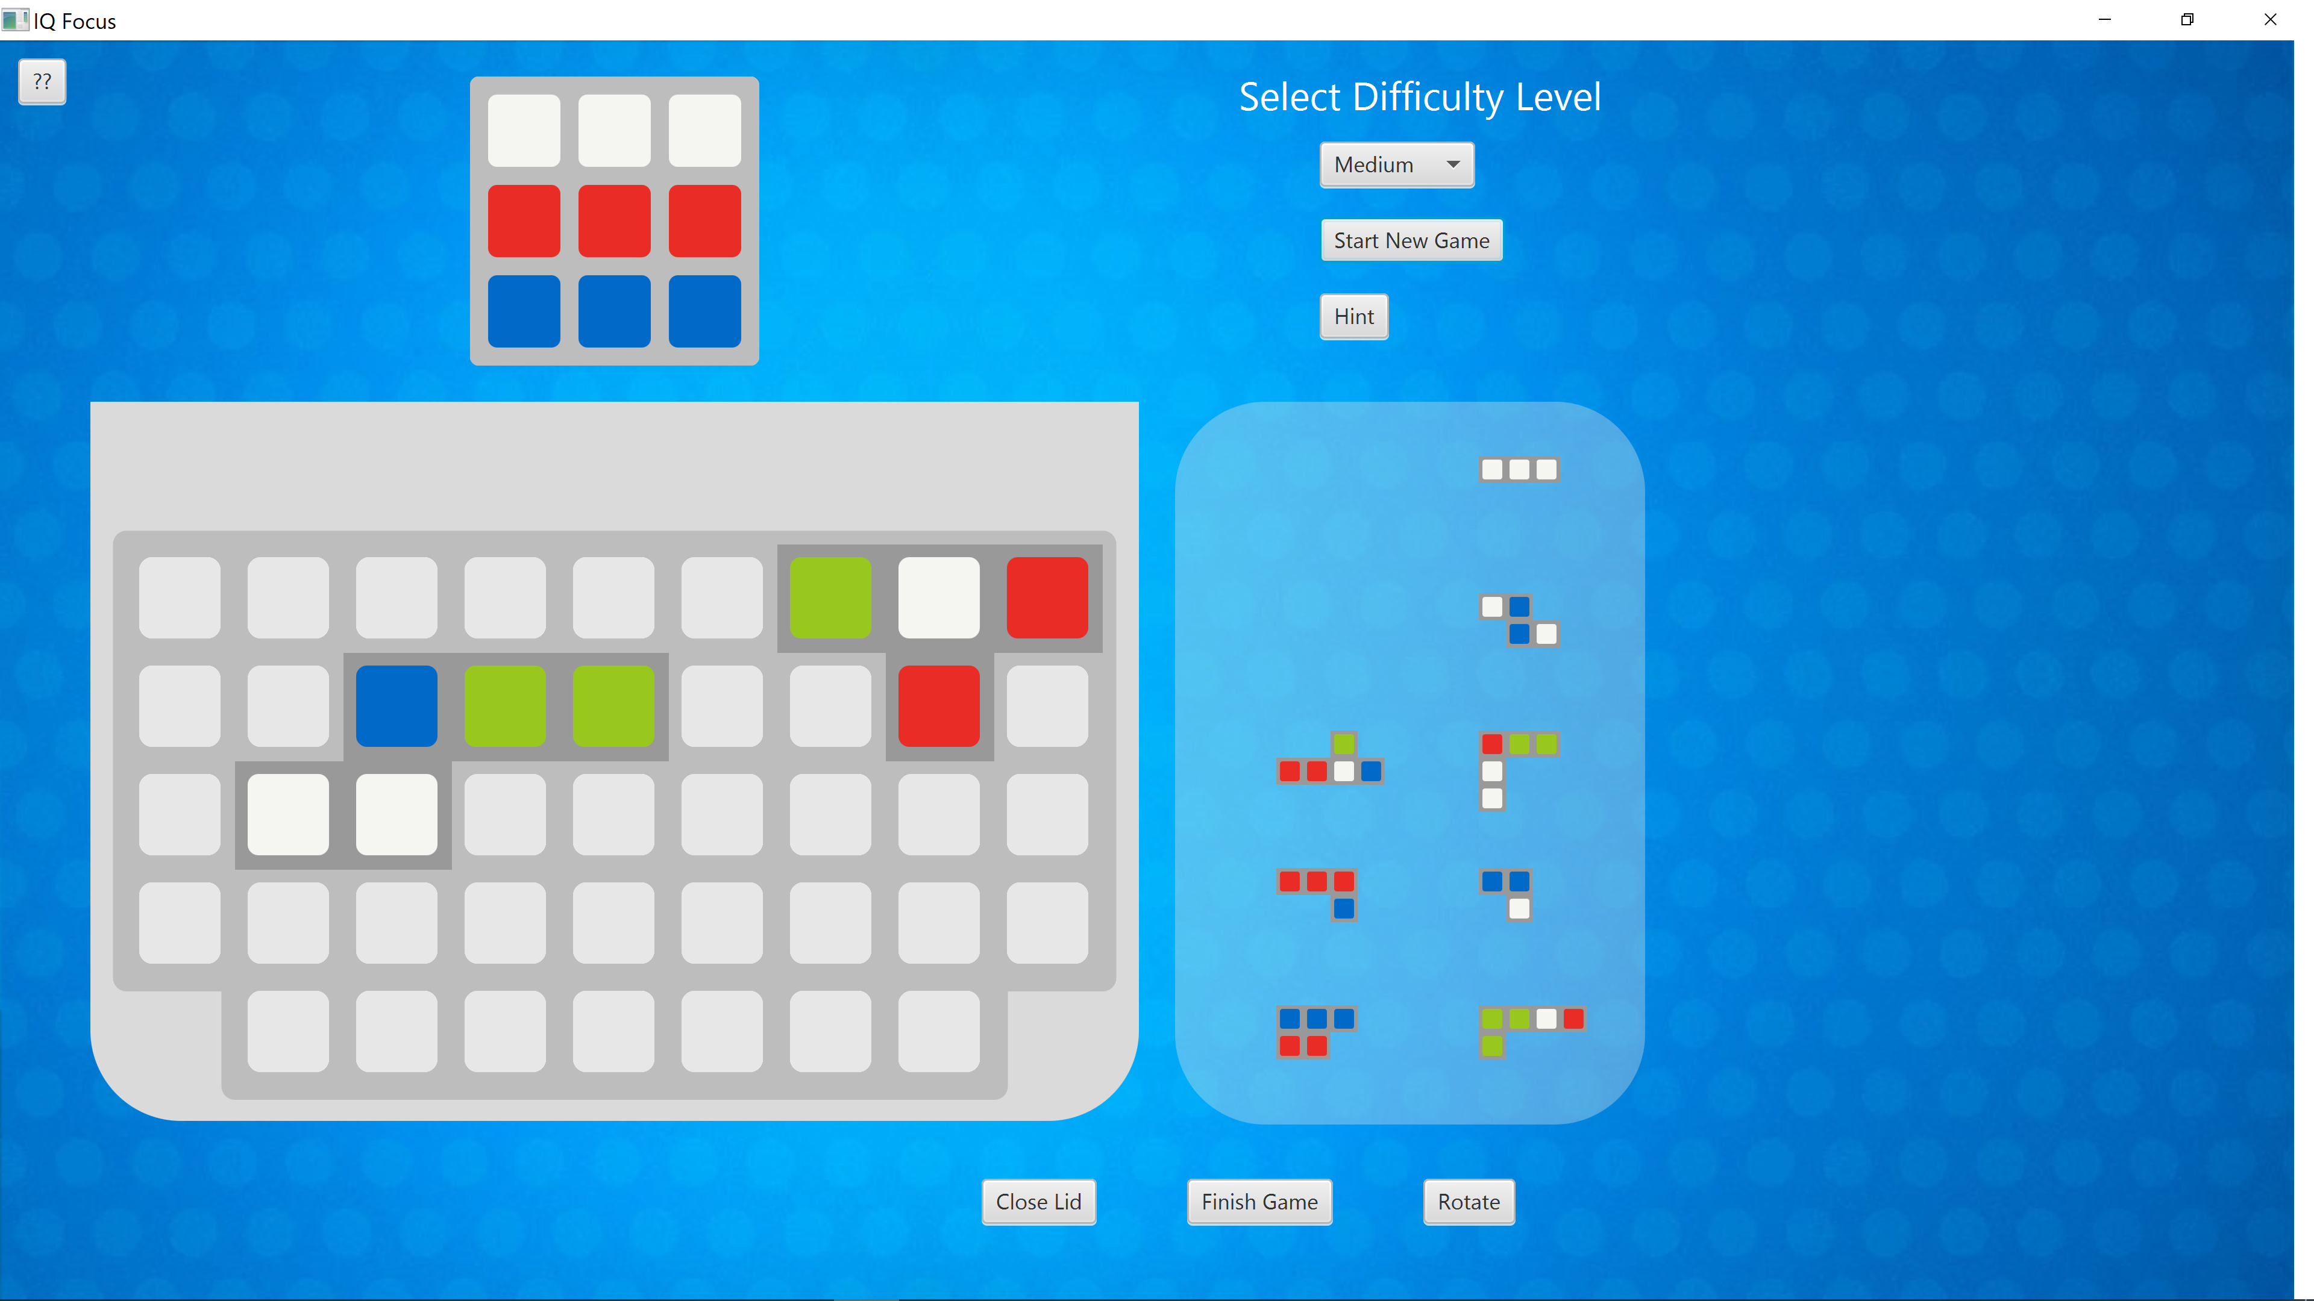

Slide 21
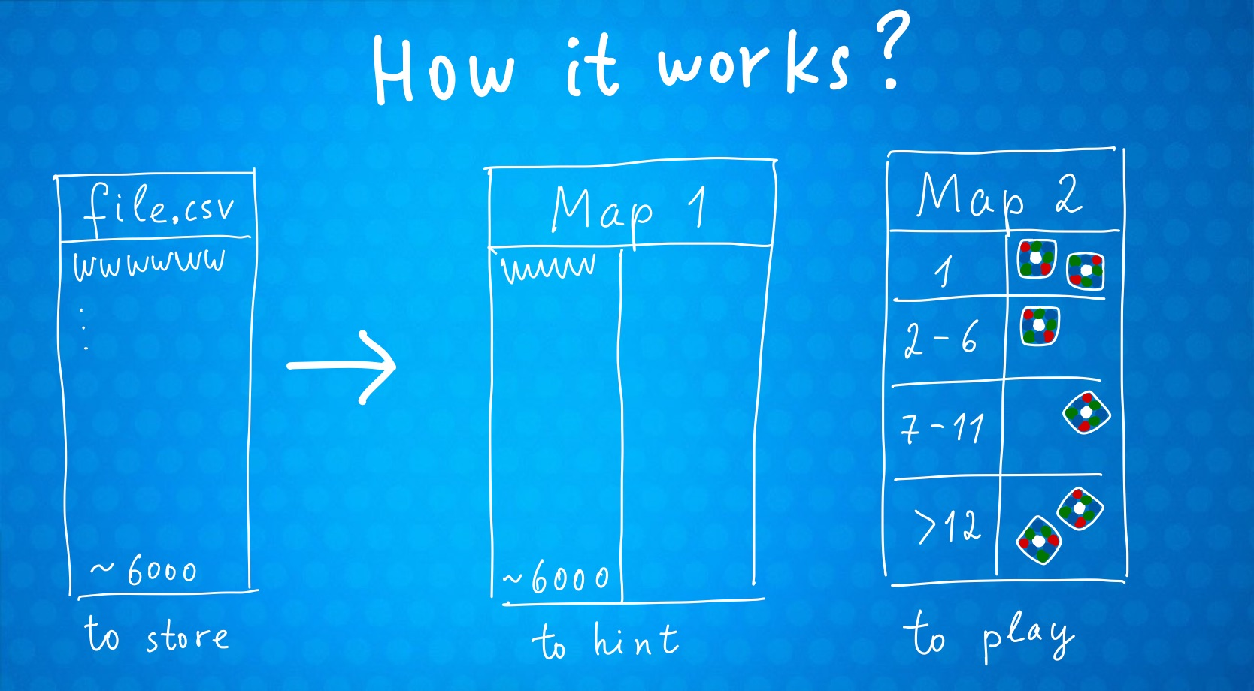

Slide 22
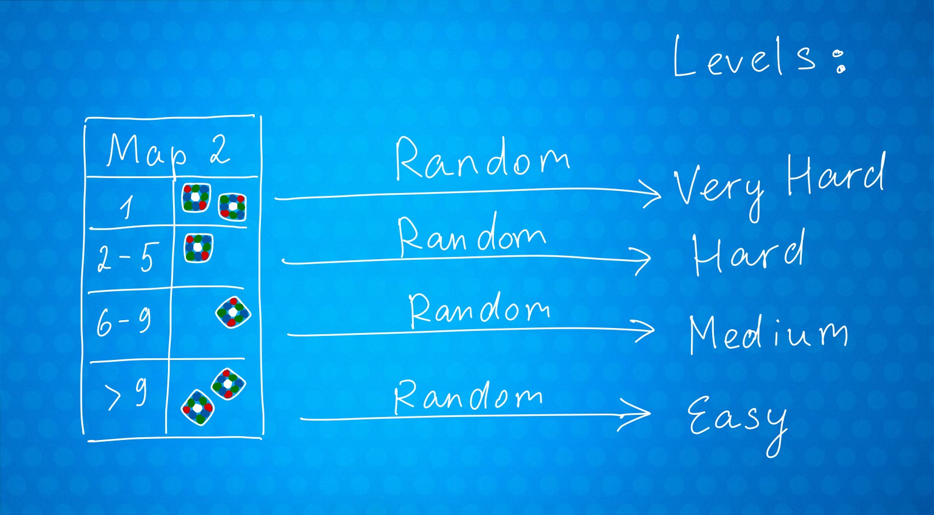

Slide 23
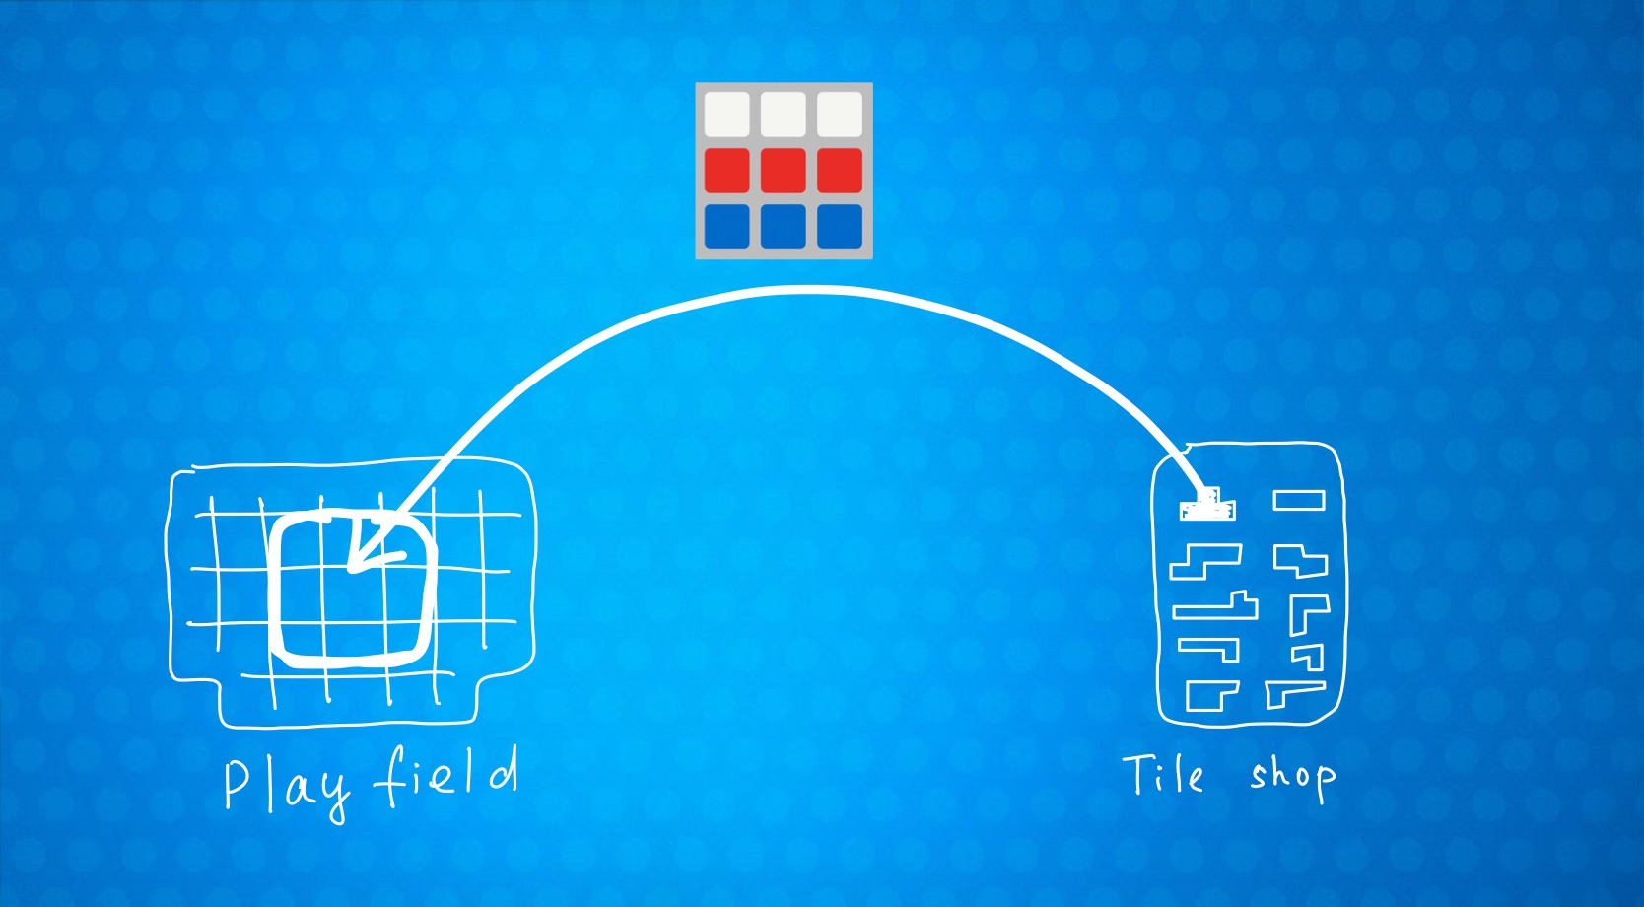

Slide 24
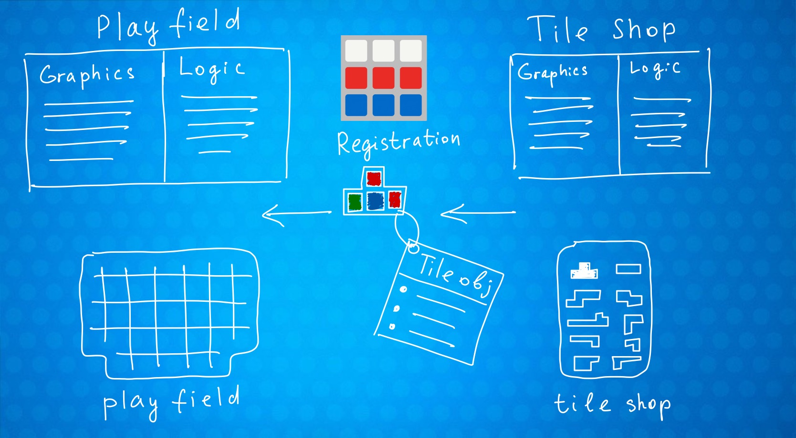

Slide 25
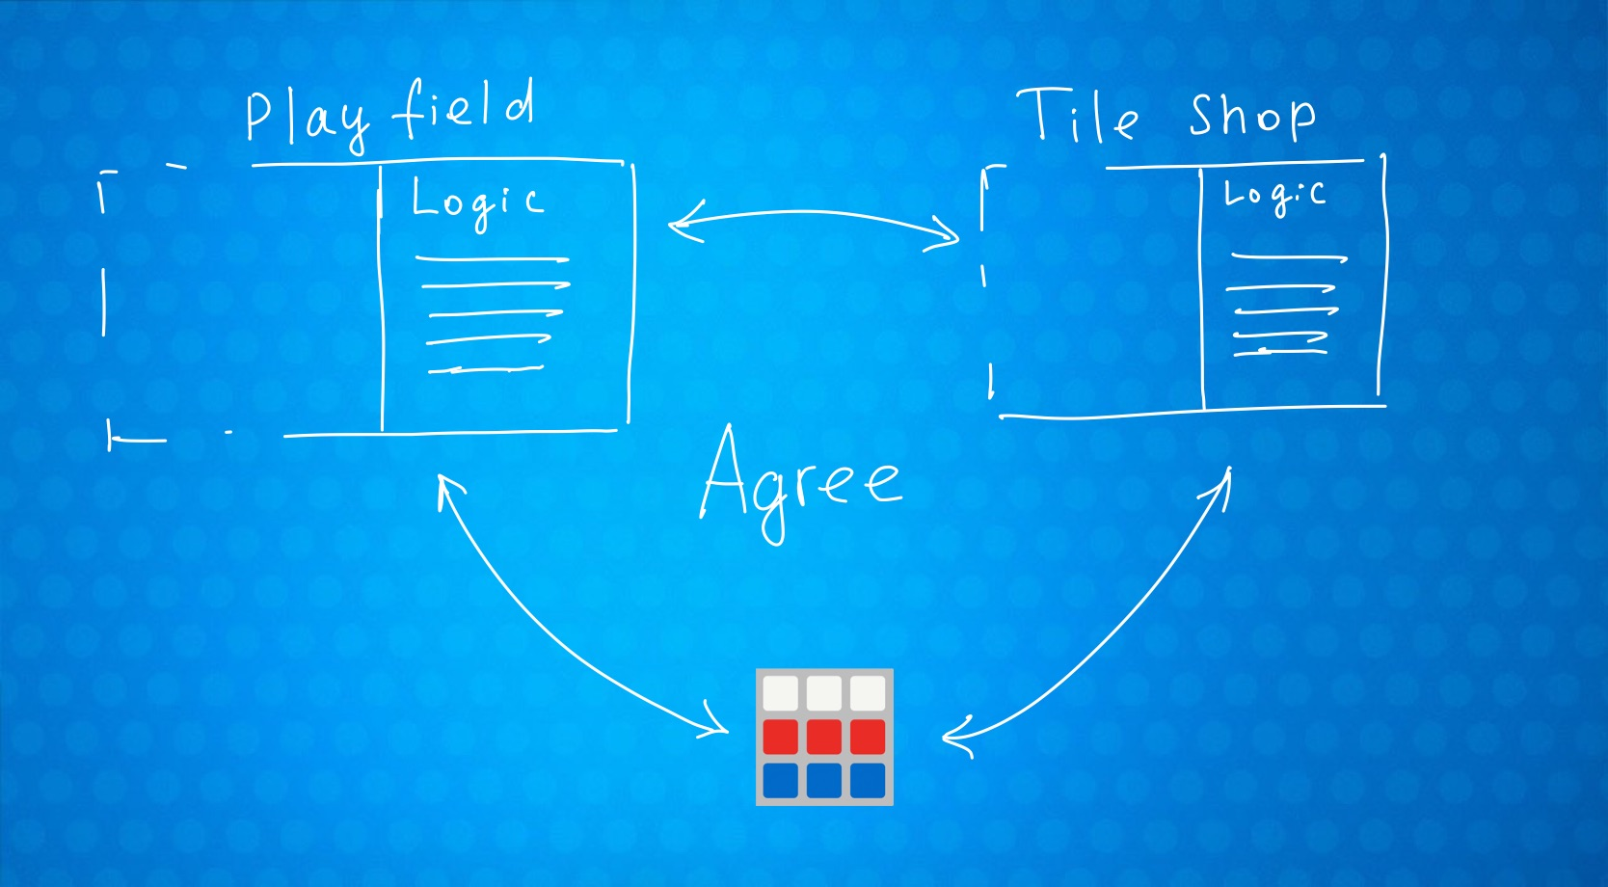

Slide 26


Slide 27
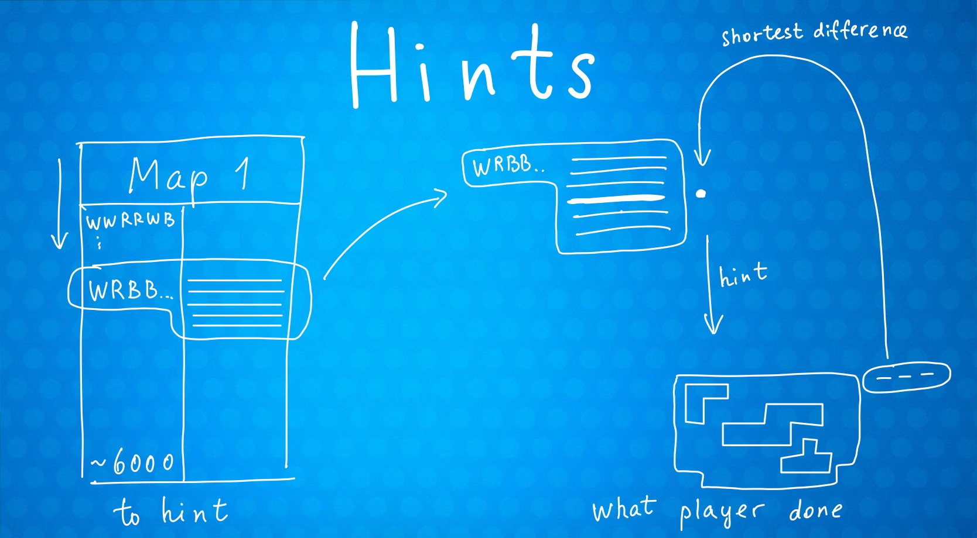

Slide 28
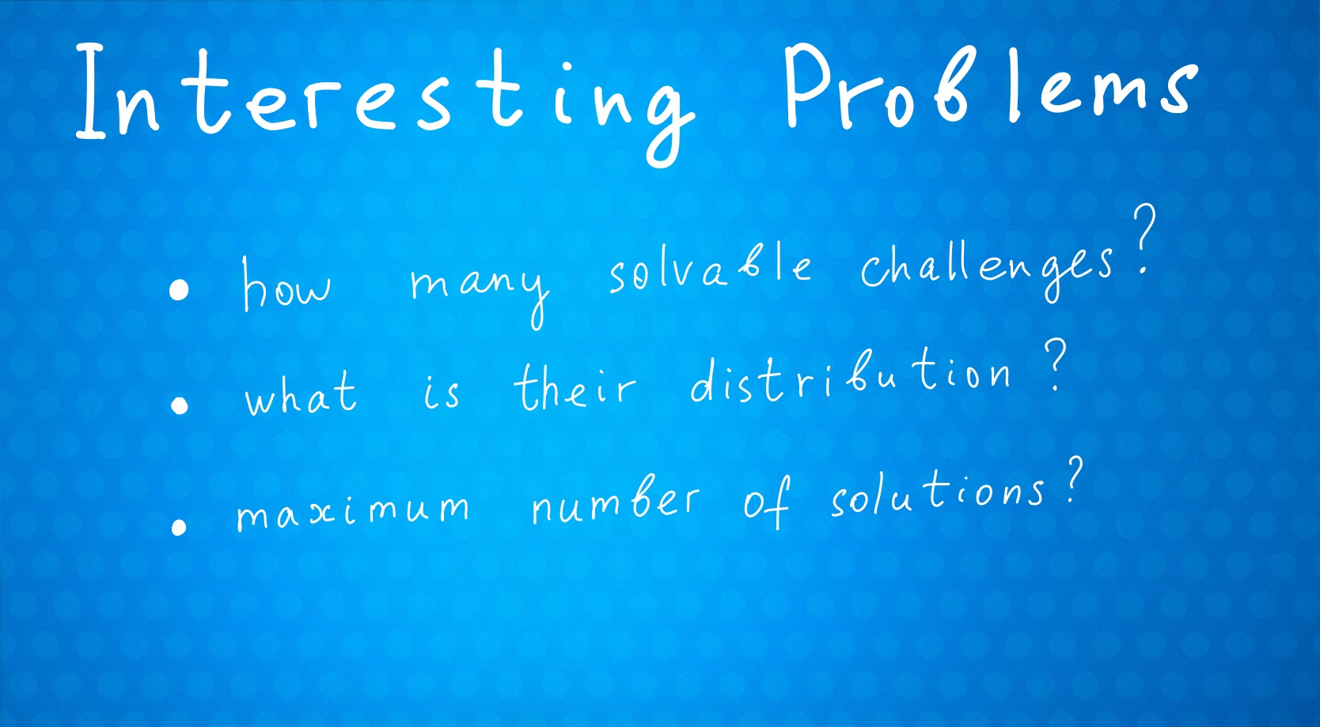

Slide 29
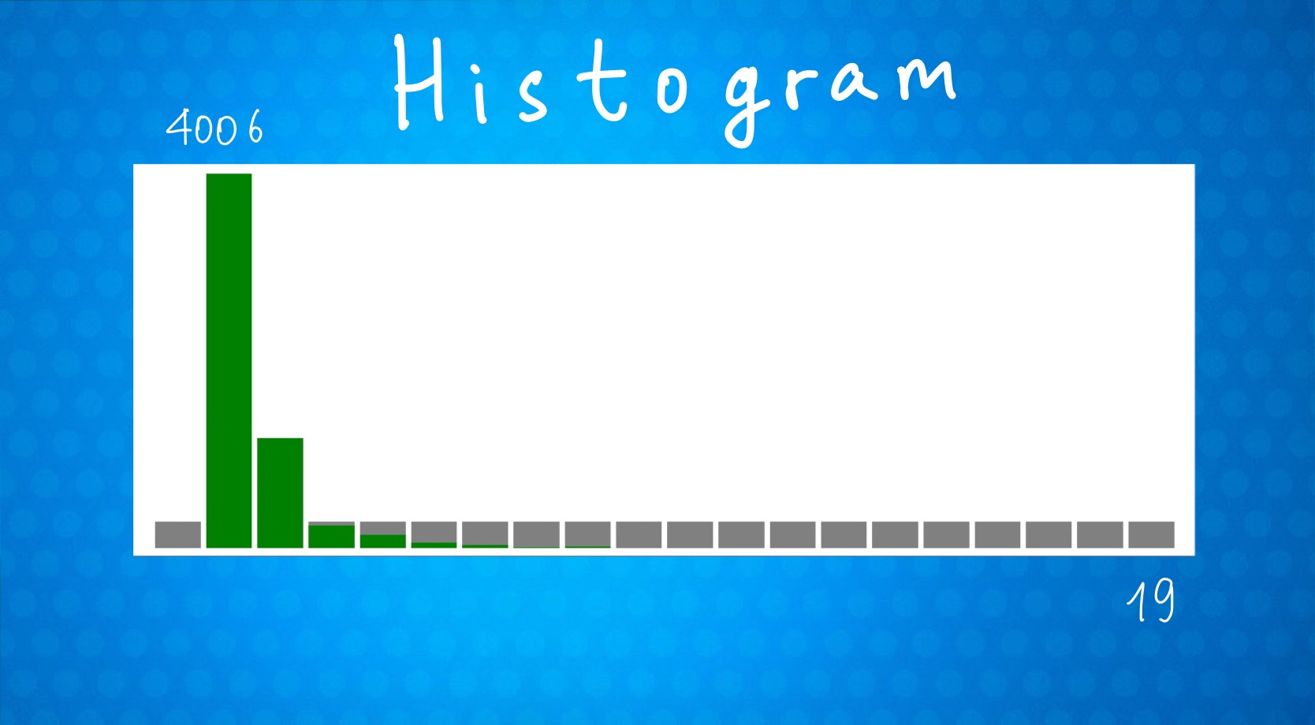

Slide 30

256417 challenges have 0 solutions
4006 challenges have 1 solutions
1180 challenges have 2 solutions
250 challenges have 3 solutions
145 challenges have 4 solutions
65 challenges have 5 solutions
40 challenges have 6 solutions
10 challenges have 7 solutions
17 challenges have 8 solutions
3 challenges have 9 solutions
5 challenges have 10 solutions
1 challenges have 11 solutions
3 challenges have 12 solutions
0 challenges have 13 solutions
1 challenges have 14 solutions
0 challenges have 15 solutions
0 challenges have 16 solutions
0 challenges have 17 solutions
0 challenges have 18 solutions
1 challenges have 19 solutions

Slide 32
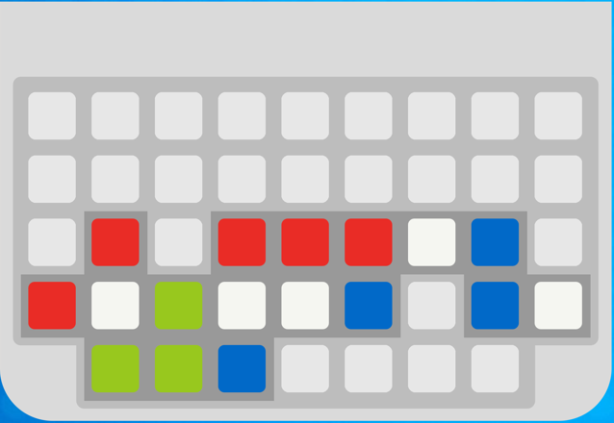

Slide 34


Slide 35


